Slide 1
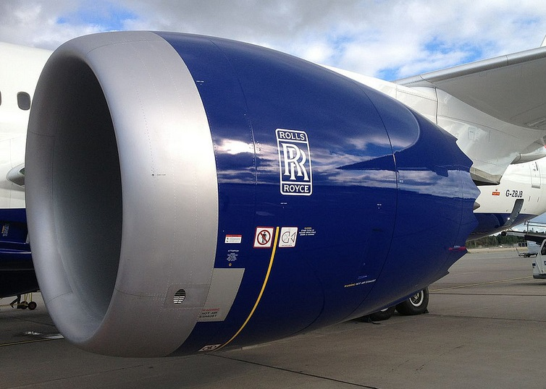
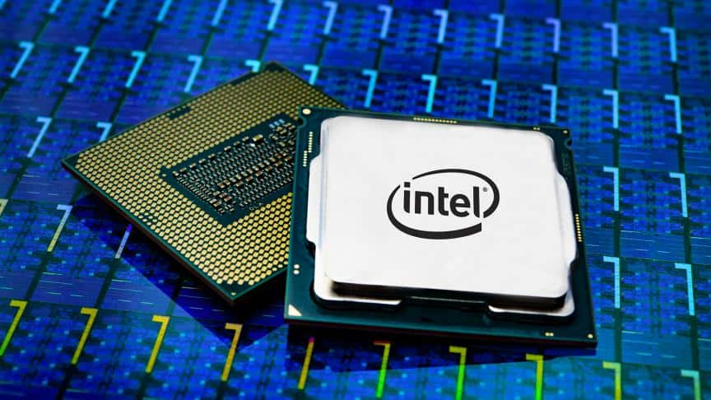
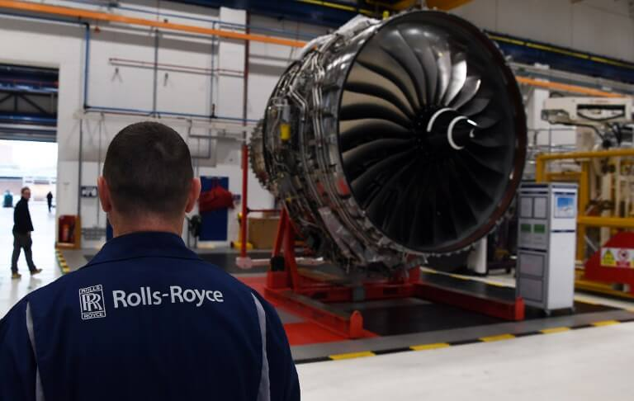

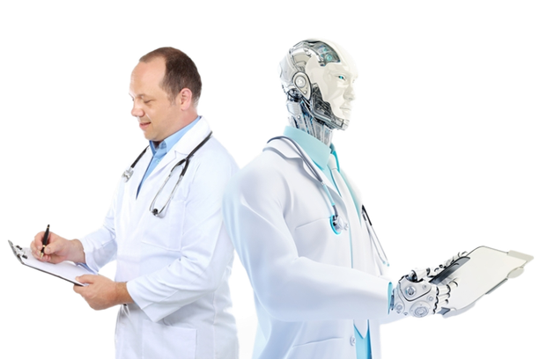
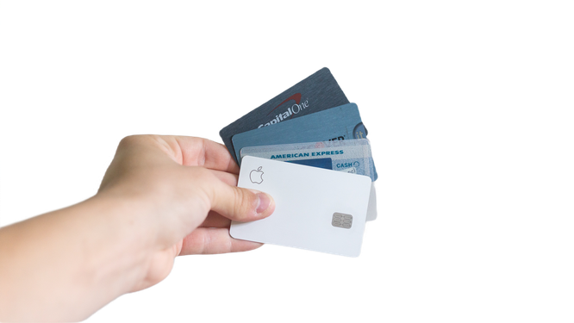

Introduction to Artificial Intelligence and Data Science

Slide 2
Why Artificial Intelligence?

Slide 3
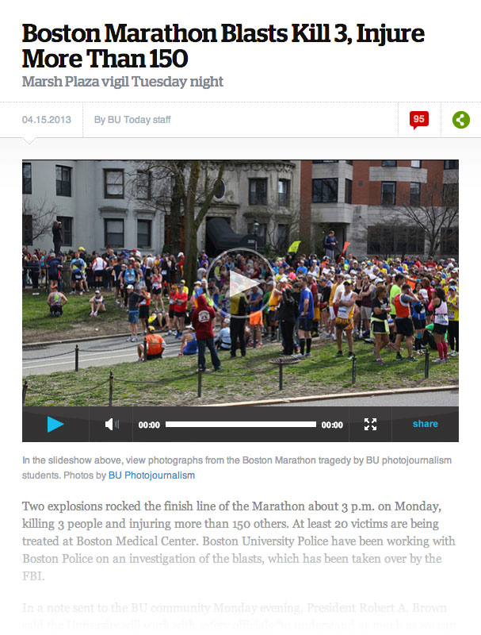
Two explosions killed 3 people and injured many at the April 15 Boston Marathon. Within 24 hours the FBI had correctly Identified the suspects. To do this, they analysed about 10 TB of data from cell phone tower call logs, text messages, social media, photographs and videos from surveillance cameras and cell phones.
How did they identify the correct suspects from the enormous amount of data in less then 24 hours?

Slide 4
Can a machine beat humans in medical expertise?
Doctors at the University of Tokyo tried for many months to diagnose the disease a lady had. They were unsuccessful.
A machine successfully diagnosed it as a rare form of leukemia in minutes. It spent just 10 minutes cross-referencing the patient’s genetic changes with 20 million cancer research papers. The finding was a life saver.

Slide 5
American Express handles over 25% of credit card activity in the USA. In 2014, they handled over $1 trillion in transactions. Fraudulent transactions are a big risk to the credit card business. They identified and prevented about $2 billion of potential fraud in a single year.
How did they do it?

Slide 6
It’s critical for Netflix to help customers find desirable content quickly.
Customers tend to give up if it takes longer than 90 seconds to find a show they want. Through better search results, Netflix estimates that it saves $1 billion annually by preventing subscription cancellations.
How do they personalize recommendations for 200+ million subscribers worldwide

Slide 7
Rolls-Royce manufactures enormous engines used by over 500 airlines and 150 armed forces.
They use AI processes in their product life cycle. They employ IoT, Cloud and Analytics in design, manufacturing and after sales support.
They use computer-based simulation and visualization to enhance their designs. Their manufacturing systems communicate with each other in an IoT industrial environment.
Rolls-Royce engines and propulsion systems record operational details in hundreds of sensors. Real time changes in data are reported to service center engineers.

Slide 8
With these insights, Rolls-Royce offered a new service model to clients called Total Care -customers are charged per hour for engine use with all servicing costs underwritten by Rolls-Royce. This pioneering business model has become a perennial source of income for the company

Slide 9
Intel does 19000 tests on every chip it makes. Using ML, Intel was able to significantly reduce the number of QA tests. They analyzed data from the manufacturing process to reduce test time and focus on specific tests. Intel saved $3 MUSD in manufacturing costs for a single line of Intel Core processors and expect to save an additional $30 million.

Slide 10
2 million+ employees.
20,000+ stores in 24 countries.
At Walmart, analytics have reduced the problem finding to solution finding period from 2-3 weeks to 20 minutes.
A grocery team couldn’t understand why sales of a particular produce were declining. Analysis established that this was due to a pricing error. Sales recovered once the error was fixed.
One Halloween, sales figures of novelty cookies were being monitored. Analysts saw that several locations weren’t selling them at all –the products hadn’t even been put on the shelves.
Analytics is used for personalization, targeted marketing and optimized scheduling for quicker delivery
While forecasting demand for emergency supplies for Hurricane Sandy, an increase in sales of strawberry pop tarts in several locations was predicted. The items were sent to these locations and sold well.
Continuously monitor performance against the target and suggest corrective actions

Slide 11
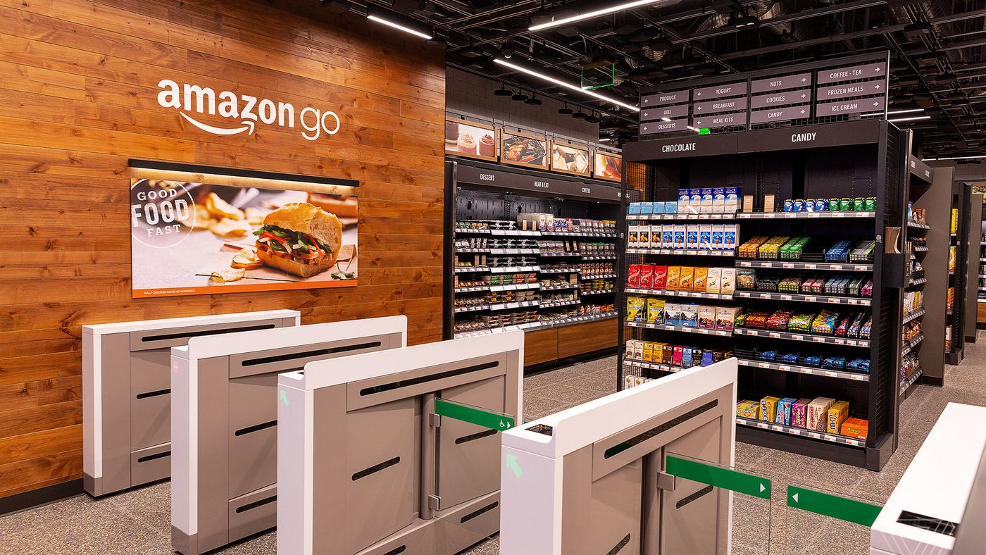
Automated convenience Stores – Amazon Go, Amazon Fresh

Slide 12
Conclusion: Adoption of AI is leading to …
Creation of new business lines
Competitive advantage
Cost reduction, increased productivity, process improvements
Personalized communication at scale
Al cantered innovations of products and processes.

Slide 13
AI trends in business and market potential
Growth in the market is driven by increasing adoption in expanding range of applications in varied industries.
Global Artificial Intelligence market predicted to touch $228.3 billion in next five years
- The Global Industry Analysts Inc

Slide 14
What is Artificial Intelligence?

Slide 15
AI defined
AI is the science of making machines do things that would require intelligence if done by men.
-Minsky

Slide 16
Aspects of AI
Planning
Vision
Speech
Speech to text
Text to Speech
Image recognition
Machine vision
Artificial
Intelligence
Machine Learning
Natural Language Processing
Deep Learning
Unsupervised
Supervised
Text generation
Question answering
Content extraction
Classification
Machine translation
Expert Systems
Robotics

Slide 17
Designing AI Systems…
Will an aircraft engine component function normally or fail in next 200 hours ( based on the performance data obtained from the sensors)?
How much lone can be sanctioned to a company so that it would be repaid back, considering their financial performance data?
What are the chances that the patient, admitted in ICU will survive, give his medical test performance?
What is common in these requirements?

Slide 18
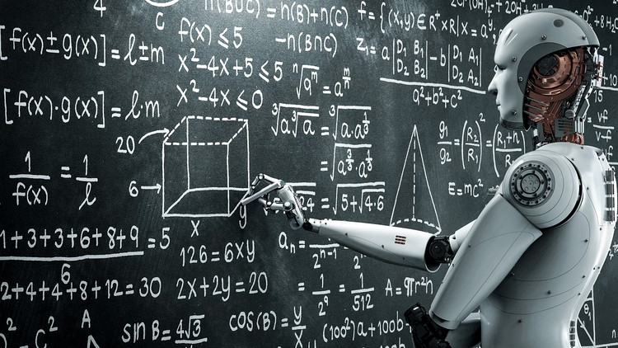
Machine Learning is all about predictions.

Slide 19
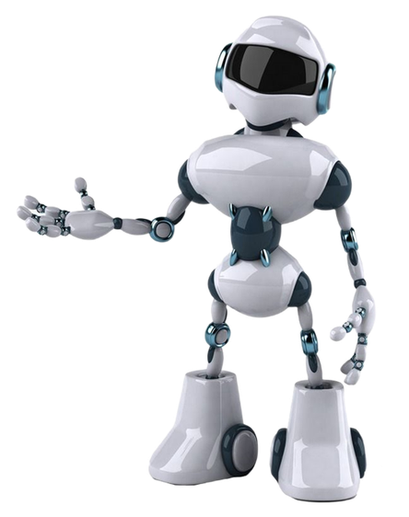
How does a machine make predictions?
It learns patterns from the past data and makes a model. This model is used to make predictions for a new data.

Slide 20
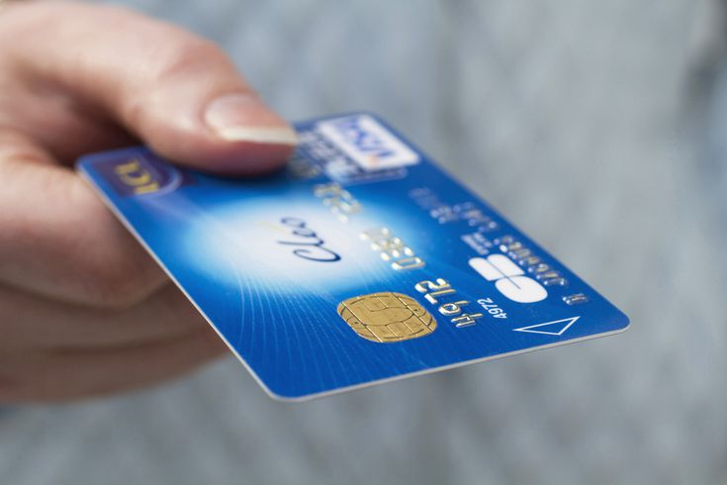
What is Learning?
Learning is the pattern / relation in the data.
Requires training data on which the system is trained.
The system learns from the data.
The learning is empirical and not causal.
Example
Bank has provided the personal and financial information for the clients along with their credit card payment history (defaulter / regular). They want to build a model that, given new data, can predict the risk associated with issuing credit card to this customer.

Slide 21

Machine Learning types

Slide 22

Machine learning concepts

Slide 23
Machine learning concepts
What type (of object, quality, ….) is it?

Slide 24
What is the key requirement in these situations?
A UK retailer wanted to build a model that would signal -shipment delay / no delay based on the internal data (order placement delays, sample approval delays, etc.) and external events (political strife or climatic conditions, etc. in the supplier's manufacturing location).
Staff at Mail and post want to segregate letters into bins based on the PIN code. An OCR based solution was provided to automate the process.
The CPG company wanted a methodology by which the products could be automatically marked as "correctly / incorrectly labelled". The CPG (consumer packaged goods) client received products from multiple partners. Incorrect labelling on parts often created compliance issues. It was taking considerable amount of time in resolving issues.

Slide 25
Classification
This data shows loan amount sought and age of the people of the applicant along with status of the loan application. Can you guess if loan will be sanctioned to the customer in the last row.

Slide 26
Support Vector Machine (SVM)
The two classes are separated by a classifier.
As you can see multiple classifiers are possible.
Support vector machine is a technique to select the best classifier.

Slide 27
Support Vector Machine (SVM)
The classifier with maximum margin between classes is the best classifier.

Slide 28
Decision Trees
Study the pattern in data and come up with a rule. This rule is expressed as a tree. Simple and easy to interpret – if loan amount is “large” and applicant is “young” then “sanction” the loan.

Slide 29
K- Nearest Neighbours
Classification of new data can be estimated by looking at the classification of the data in the neighbourhood.
Can you guess the decision for new data? Loan amount sought: $3000 , age: 45 years.

Slide 30
Bayesian Classifier
For the following data what is the probability that the customer (in the last record) will get the loan sanctioned?
A Bayesian classification modal considers the probability of getting the loan for each attribute : what is the probability of getting the loan sanctioned when the loan amount is small; what is the probability of getting loan sanctioned when the person is young.
The individual probabilities are combined to arrive at the final probabilities of getting the loan for the customer.
Simple to compute.
Useful when the data is small.

Slide 31
Machine learning concepts
What value should it take?

Slide 32
What is the attribute of the data that we want to predict?
A bank wanted to decide the credit limit of a new credit card application.
A US wealth management organization wanted to predict the risk in monetary transactions as it saw substantial risk of fraudulent transactions by money transfer company operating in African countries.
A wind energy company wanted precise prediction of wind detection. It saw significant loss in power production as wind turbine sonic anemometers were not able to capture wind direction accurately.

Slide 33
Predicting numeric values is done using a technique called Regression.
Given the past data as shown, how much loan a customer of age 30 will apply for?
Create a model(linear regression) with past data
Use the model for predictions.
Relation between age and loan amount

Slide 34
Regression
Relation between age and loan amount
This concept is used in forecasting such as demand forecasting, stock market, forex etc.

Slide 35
Machine learning concepts
What is the probability that:
The object is of type A?
Event A will happen?

Slide 36
What do we want to know about these events?
Xerox research problem: Based on the medical test parameters, what are the chances that a patient admitted to the ICU will survive?
Based on the given data – personal and financial, what is the likelihood that this person will default in his EMI payment?
Given the transaction data (amount, time, place to transfer, transaction history), what us the probability that the transaction is fraudulent?

Slide 37
Logistic regression is about estimating the probability of an event
The data shows the incidence of Coronary heart disease (CHD) for patients across ages between 20 and 69 years.
Logistic regression model is built to predict the prob. Of CHD for any patient given age of the patient.
This is done using a sigmoid function that converts the occurrence of event into probability.

Slide 38
Logistic Regression is about estimating the probability of an event.
Finding the probability for a given data to belong to a particular class.
A special function called logistic function is used (‘S’ shaped), shown in the diagram
From the diagram, can you observe that the y-value lies between 0 and 1.–Can I use this value as probability.
Independent variable is quantitative and response variable is qualitative.
It is useful to find the probability of loan to be sanctioned for an applicant whose age is 45 and seeking a loan amount of $3000

Slide 39
Machine learning concepts
Is the data structured as groups?

Slide 40
How to gain insight from an unlabelled data?
Law enforcement agencies / fire tender service / ambulance services are to be located at places that can best serve the people. It also needs to take care of changes in population and predict areas where the services are deficient and new ones are to be added.
A European and APAC Telco observed that their campaign was not effective. It lead to in low Average Revenue per Unit (ARPU) and customer churn. The Telco major ran campaigns on pre-specified customer segmentation based on historical usage and spending patterns. They wanted to run a targeted and personalized campaign.
A retail chain wanted to figure out the locations of stores so that it is well placed to serve the customers and optimize the gains. They wanted to gain more insight based on consumer demand, demographics, competition proximity etc.

Slide 41
Clustering
Clustering in business is about getting meaningful groups.
Every element in a group is more similar to other elements than elements in another group.
Applied on unlabeled data.
Similar data are grouped together.
K-mean is a popular algorithm for clustering

Slide 42
Can this behaviour be leveraged to improve sales?
High net worth individuals prefer high risk investment products.
Most people who purchased health insurance purchased term insurance.
People who purchase bread are highly likely to purchase butter.

Slide 43
Association Analysis: Things that are demanded together
Frequently bought together
Customers who bought this item also bought

Slide 44
Is there a predefined formula to achieve these?
A bank wants to automate the process of checking if a signature belongs to right customer in cheques.
A big multinational company wants to identify employees from face and scrap the smart card.
Postal department wants to sort letters automatically by recognizing hand-written pin codes
How can a system process the data like a human?

Slide 45
Artificial Neural Networks
Human endeavor to create a machine that works like the human brain.
Like the human brain, given the inputs and the outputs, figure out the relations automatically. An excellent model for “machine brain”
This is contrary to our learning model –we establish cause and effect in our thinking. When we get an input, we apply this thinking and predict the effect.
The learning of the model is still not comprehensible to us.
Extended ANNs gave rise to deep learning models.

Slide 46
The human neuron

Slide 47
Artificial Neural Network

Slide 48
Overfitting : Learning vs Memorizing
This is about model complexity. Over fitted model is complex.
Over fitted model tend to memorize rather than learning.
Poor performance and error prone.

Slide 49
Bias – Variance : Model Performance
Low Bias
High Bias
How far your prediction from actual?
Are they consistent?
Which is more desirable among the four cases?
When complexity of the model is low: High Bias and Low Variance.
With increasing complexity: Low Bias and High Variance.
It is a tradeoff
Low Variance
High Variance

Slide 50
Ensemble methods: Combining Models for better results
As an orchestra combines different instruments to produce better music, multiple learning technique scan be combined for better predictive performance.

Slide 51
Ensemble methods: Random forest
Create multiple decision trees by selecting random number of features.
The results of these decision trees are aggregated to enhance predictive performance.

Slide 52

How will the past and present impact the future?
Time series methods

Slide 53
Can we tell the future from the past and present data?
An economist wants to forecast the GDP for the next year.
A company wants to forecast the sales for the next quarter.
An investor wants to do Stock Market Analysis.

Slide 54
Timeseries : forecasting

Slide 55
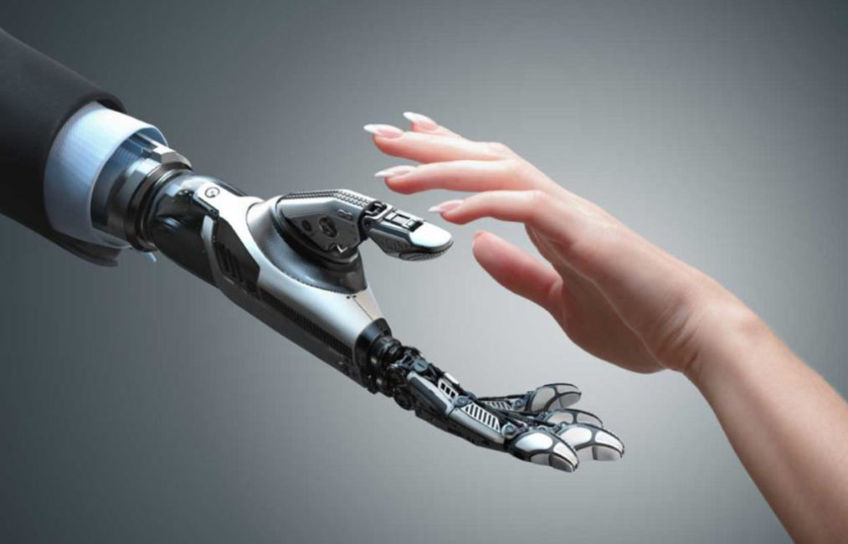
Can machines understand knowledge available in human languages?

Slide 56
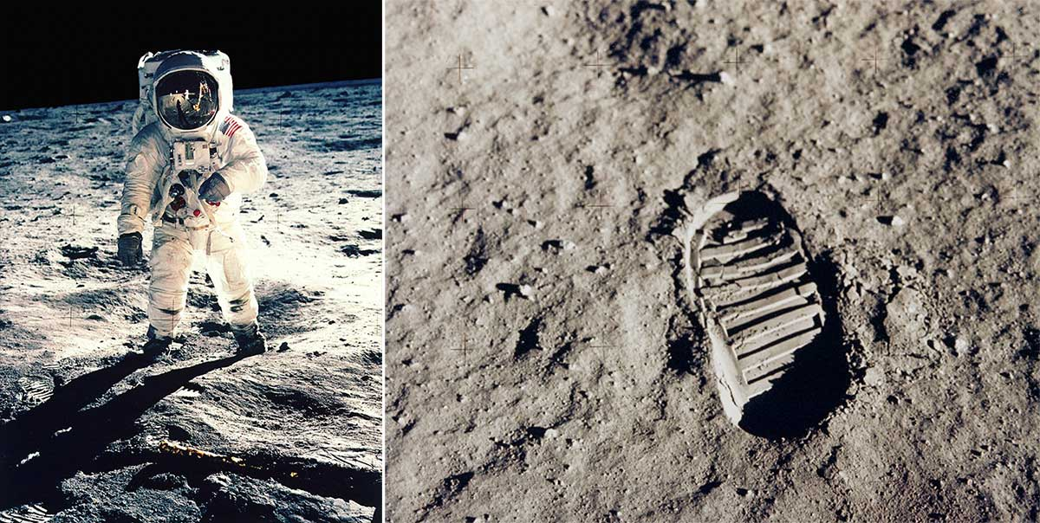
Apollo-11 moon landing mission and NLP
The LUNAR system was designed as a language interface to give geologists direct access to a database containing information on lunar rock and soil compositions obtained during the NASA Apollo-11 moon landing mission.
The design objective was to build a system that could respond to natural queries received from geologists.
What is the average basalt content?
What is the average concentration of aluminum in the high alkali rocks?

Slide 57
Can machine understand knowledge available in human language?
Banks have a written SOP for handling money laundering cases. Can a system understand these processes and apply them to each of the transactions for AML compliance?
Can machine extract data from social media and do sentiment analysis?
Online medical services company has lots of non-native speakers. It would like to design a system/app to check if their customers are doing good.

Slide 58

Can machines understand knowledge available in human language?
Can machines communicate with humans in their language?

Slide 59
NLP examples?
Levi Strauss & Co. announced an AI-based chatbot tool called Virtual Stylist: personalized sizing recommendation technology from True Fit. It helps users determine which pair of jeans is the best fit for them.
HDFC Life, one of India's leading private life insurance companies, announced the launch of India's first life insurance chatbot. The chatbot will act as a financial guide to help users choose the most suitable life insurance plans and solutions.
Bots have also made inroads into the Indian wealth management industry. Chatbots are providing investment advice to clients.
The operator of one of the largest freight railroad network in North America employed unionized labor and had multiple labor contracts with the different unions it worked with. Any labor related query or exception needed to be addressed in accordance with the rules defined in the pertinent labor contract. This resulted in long lead times to resolve exceptions. The client needed a knowledge model (for all labor contracts) and a conversational interface that provided natural language query into the knowledge models.

Slide 60
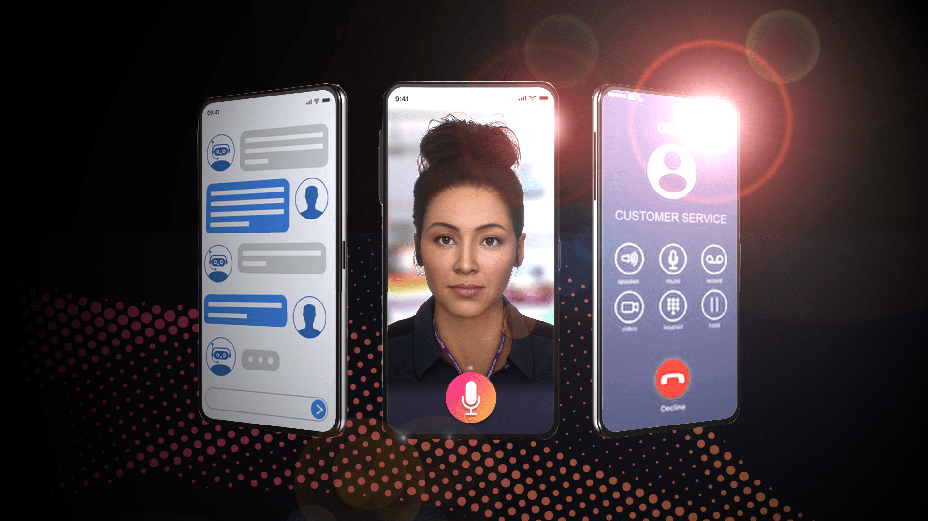
AI is the new UI
Chatbots help people access the knowledge repositories in natural language. The user experience is like talking to another human being.
Gartner: Chatbots driven by artificial intelligence (AI) will play important roles in interactions with consumers, within the enterprise, and in business-to-business situations. By 2019, more than 10% of IT hires in customer service will mostly write scripts for bot interactions.

Slide 61
Artificial Intelligence in Practice

Slide 62
Putting the concepts together : ML Process
Historical data from various sources are cleaned and subjected to feature Engineering where significant features are selected. This engineered data is divided into two sets: Train data and Test data. Machine learning models are built using train data which are validated using test data. This validated model is used for prediction.

Slide 63
How AI can help
An insurance company employs 500 people to detect insurance claims manually. The suspect claims are then sent to a team of inspectors to physically verify them. The insurance company feels that the process is slow and costly.

Slide 64
Fraud detection

Slide 65
How AI can help the apparel retailer?
A global apparel retailer was dealing with an extended product development cycle resulting from multiple design iterations to meet targeted cost. This was a result of variability in manufacturing (labor and material) cost between the design and development stages. The client was looking to leverage data analytics to accurately predict overall cost of production during the design stage.

Slide 66
Apparel Retailer

Slide 67
How AI can help to client?
A client has a high cost of maintaining a call center for answering routine customer queries, logging service requests against complaints etc.

Slide 68
NLP Process

Slide 69
Association analysis: How can AI help find such product combination?
Retail Kart hypermarkets worldwide want to Improve shopping experience and cross-selling of products by co-locating products that have a high likelihood of being purchased together ( e.g., Biscuits, Tea, milk whitener).
A customer on an online store wants to purchase a book on AI. The seller wants to make suggestions for up-selling and cross-selling.

Slide 70
Association Analysis

Slide 71
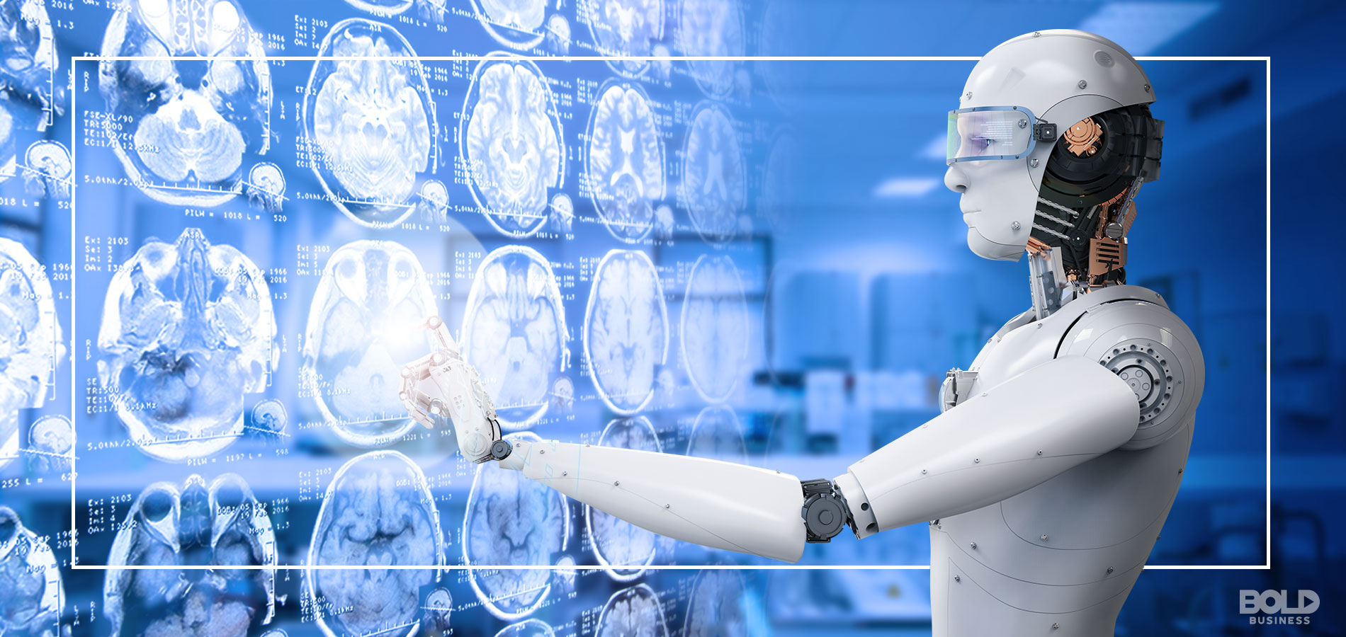
Medical Imaging: How can AI help?
A hospital manually checks MRI images to detect brain tumors. Doctors have to go through a number of images for this. It takes a lot of time and is subject to human errors.

Slide 72

A retail shop wants to create high level categories for unlabeled products using images of products as inputs.

Slide 73
Medical Imaging

Slide 74
Putting them all together – AI architecture

Slide 75
AI led business process transformation

Slide 76
AI led business process transformation – Insurance Claim Process
Insurance Claims cost almost 80% of the premium income.
Time consuming , labor intensive , laws require settlement of claim within stipulated period
How has AI led to the transformation of the entire claims process?

Slide 77
AI led business process transformation – Insurance Claim Process

Slide 78
Cont.… AI led business process transformation – Insurance Claim Process
The business process is now almost completely Automated.
Reduce claims “leakage”: the dollars lost through claims management “inefficiencies”.
Enhances customer experience and satisfaction.

Slide 79
Business Process Transformation using Cloud, Big Data and AI - Amazon
AMAZON has gained market Leadership by use of technologies (Is in the list of top 10 retailers in US).
It has Built Competitive edge by using Cloud, Big data & AI technologies.
80% of e-commerce giants say that they lag Amazon in analytics maturity -EKN Research

Slide 80
Business Process Transformation using Cloud, Big Data and AI - Amazon

Slide 81
Business Process Transformation using Cloud, Big Data and AI - Amazon

Slide 82
Artificial Intelligence in Business

Slide 83
What do you think is the problem
A software company uses 100 employees to manually verify the travel claims submitted by its employees. The work is laborious , monotonous and costly.
A company is not aware what the customers feel about its newly launched product.
An online retailer does not know which products to up-sell or cross-sell to a customer.
Do you see such trends in other business areas?

Slide 84
Dark data & the big AI opportunities
The company is not using its data to improve its systems/product/processes.
Dark data is the information assets organizations collect, process and store , but generally fail to use for tangible and intangible gains –Gartner
80% of the data is Dark –IBM
But this is fast changing, and it is creating a huge market potential for AI.

Slide 85
AI and business – The emerging trends
By 2020, 85% of customer interaction in retail will be managed by AI –Gartner.
Walmart to gain $18.5 billion in additional profits by implementing AI solutions.
AI software to grow for $664 M in 2016 to $37 billion in 2025.

Slide 86



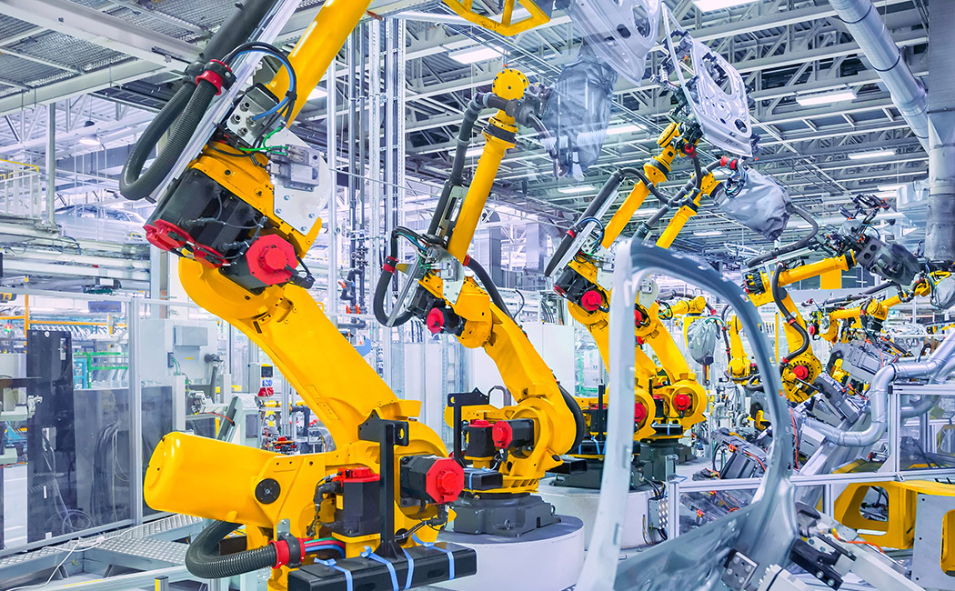

Applications of AI
Retail
Healthcare
Banking
Manufacture
Energy

Slide 87
AI in Retail
Amazon
Puma
Flipkart
Amazon
Tesco

Slide 88
Retail: Ai will manage 85% of customer interactions in coming years
Benefits
Computers will converse with clients in human languages. Will understand their needs and emotions and assist them in selection and solving issues.
Personalized service.
Technologies
NLP
Speech recognition
Companies
Alexa -Amazon

Slide 89
Retail: Ai will manage 85% of customer interactions in coming years
Benefits
Contextual commerce is an online content –videos, articles, reviews, photos –from which consumers can buy the items featured within it directly, without being redirected to another site
Technologies
Optimization, NLP, Machine learning
Companies
PUMA, Bazaar, Ted baker

Slide 90
Reaching the right person with the right offer through the right channel at right time
Benefits
Analysis of data that can be put into well defined action geared towards specific results.
Inventory management, pricing, targeted campaign
Technologies
Machine learning, Big Data
Companies
Amazon, Filpkart

Slide 91
Retail: Using AI to make better decision about the world we want to see
Benefits
To extract information from customer data sets to determine a pattern and predict future outcomes and trends.
Can help generate more revenue by targeting only potential customers.
Technologies
Machine Learning, Expert Systems
Companies
Amazon, Myntra

Slide 92
Retail: Sell smarter with AI
Benefits
Understanding Needs
Suggesting the best match.
Technologies
Machine Learning, Expert Systems
Companies
Tesco

Slide 93
AI Based Retail Strategies

Slide 94
AI in Healthcare
SEIMENS
INTUITIVE
Surgical
SENSELY
KPMG
Manipal
Hospitals
Backus
Hospital

Slide 95
Healthcare: AI assisted Medical Image Diagnosis
Benefits
Radiologists can work faster and accurately.
It can identify anatomical features and abnormalities in medical images such as CT scans, X-ray and MRI scans.
Also draws on text and other data in a patient’s medical record to suggest possible diagnoses and treatments.
$3B
Technologies
NLP, Machine Vision

Slide 96
Healthcare: AI Assisted Medical Surgery
Benefits
n robot assisted surgery, surgeons use a computer-controlled robot to assist them in certain surgical procedures.
Complex surgical tasks can be performed through tiny incisions.
Greater precision.
$40B
Technologies
Robotics, Machine Learning
Companies
Intuitive Surgical

Slide 97
Healthcare: AI enabled Virtual Nursing Assistants
Benefits
Clinicians to seamlessly monitor risk factors and adjust clinical protocol as needed.
A personalized care plan at home itself.
$20B
Technologies
NLP, Machine Learning, Image Analytics
Companies
Sensely –Molly(nurse)

Slide 98
Healthcare: AI assisted Fraud and abuse detections
Benefits
Extracts useful information from thousands of claims for detecting health care fraud and abuse.
Efficient and effective IT-based auditing system.
$17B.
Technologies
Machine Learning, Expert Systems
Companies
KPMG

Slide 99
Healthcare: AI assisted Disease detections
Benefits
Can automatically detect diseases.
The waiting time of the patients to get pathology reports would be reduced.
Helps to avoid the more time-consuming methods for visual medical diagnosis and makes the process faster.
$5B, $17B
Technologies
NLP, Machine Learning, Data mining
Companies
Manipal hospital with IBM Watson

Slide 100
Healthcare: AI assisted Resource Management
Benefits
Making best use of both humans and AI talent.
AI offers a way to fill in gaps amid the rising labor shortage in healthcare
$17B
Technologies
Machine Learning, Expert Systems
Companies
William Backus hospital

Slide 101
AI and Banking
Bank of America
State Bank of India
J.P. Morgan
Reserve Bank of India
HDFC Bank
Bank of America

Slide 102
Banking: AI based solution for Risk Estimation
Benefits
Determination of the estimate of risk related to a situation
Credit risk or Liquidity risk for example.
Technologies
NLP, Machine Learning
Companies
Bank of America

Slide 103
Banking: AI based investment banking solutions
Benefits
Management of bonds, securities, shares etc.
Real time optimization of sales and marketing interactions and client services , predictive market modeling based on instantaneous processing of teraflops of data.
Technologies
Machine Learning, NLP
Companies
SBI, HDFC bank

Slide 104
Banking: AI based trading solution
Benefits
Develop new strategies for trading volatility on behalf of clients.
Can examine vast amounts of trading data and build a strategy based on learning from market patterns
Technologies
Machine learning, Analytics
Companies
JP Morgan

Slide 105
Banking: AI assisted operations
Benefits
AI can capture complex patterns in customer data and exploit these patterns to identify likely defaulters.
Uses patterns that traditional underwriting models do not account for
Technologies
Machine Learning, Expert Systems
Companies
RBI , Bank of America

Slide 106
Banking: AI based Customer Care support
Benefits
Computer guides people on processes.
Advises on investments.
Takes care of support issues.
Technologies
Machine learning, optimization, planning
Companies
HDFC –Robotic assistant IRA

Slide 107
Banking: AI assisted Compliance Check
Benefits
Thousands of hours are spent in regulatory compliance filings to determine whether they comply with laws, terms and conditions.
Using AI banks may be able to save 30% of compliance costs while accelerating throughput up to three times
Technologies
NLP, Machine learning
Companies
Bank of America

Slide 108
AI in Manufacturing
SIEMEMS
Rethink Robotics
GE
PLETHORA
Amazon

Slide 109
Manufacturing: Smarter manufacturing
Benefits
Products are already created in the virtual world.
Security optimization, being tested and refined in the virtual world.
Manufacturing processes are also on track to being developed, tested, and optimized this way.
Technologies
Machine learning
Companies
Siemens

Slide 110
Manufacturing: Adaptive manufacturing
Benefits
Humans and robots work side by side for maximum effectiveness
Overcomes drawbacks of industrial robots (e.g., they require hours to reprogram)
Easy, cost effective
Technologies
Machine Learning, Robotics
Companies
Rethink robotics

Slide 111
Manufacturing: AI based Predictive maintenance
Benefits
Equipment can interpret data from hundreds of sensors, understand failure conditions, track anomalies, based on real-time demand.
This allows manufacturers to achieve 60 percent or more reduction in unscheduled system downtime
Technologies
Predictive analytics, robotics
Companies
General Electric

Slide 112
Manufacturing: Boosting productivity using AI
Benefits
Monitoring and adaptive control using AI can allow you to increase the productivity
Faster feedback loops using AI can enable factories to tackle unplanned downtimes
Technologies
Machine Learning, Expert systems
Companies
Plethora

Slide 113
Manufacturing: Real time demand execution
Benefits
Real-time demand visibility can be achieved by connecting consumer apps and IoT with industrial IoT.
Consumer trends and behavioral data can inform downstream supply chain and manufacturing activities
Technologies
Machine learning, information extraction
Companies
Amazon Echo

Slide 114
AI in Energy
ExxonMobil
BP
GAZPROM

Slide 115
Energy: AI assisted smarter exploration
Benefits
Geoscientists locate oil reserves using their knowledge and experience with a helping hand from AI technologies.
Testing the waters “virtually” before a drill ever disappears downhole could save a company anywhere between millions and billions.
Improve quality of seismic analysis.
$6B
Technologies
Machine learning, Expert Systems

Slide 116
Energy: AI based development solutions
Benefits
Faster delivery of capital projects from planning.
Better availability of logistics and maintenance.
Lower capital expenditure by rightsizing wells, crew.
$15B
Technologies
Machine Learning, image analytics, robotics, planning
Companies
Shell

Slide 117
Energy: AI based Onshore production solutions
Benefits
Reduce risks through predictive maintenance.
Optimize stock levels.
Faster maintenance.
Better coordination between shifts.
Better onshore offshore coordination.
$14B
Technologies
Machine learning, supervised, unsupervised
Companies
Total, Gazpromavia

Slide 118
Summary of business benefits
Competitive advantage
New Business line creation
Return on Investment (ROI)
Turnaround time improvement
Time to market

Slide 119
Artificial Intelligence Language, Tools and Frameworks

Slide 120





Programming Languages

Slide 121








Big Data Tools

Slide 122






Machine Learning Frameworks

Slide 123




Cloud Platforms

Slide 124

Computer Vision

Slide 125





Natural Language Processing Tools

Slide 126





ML Operations (MLops)

Slide 127



AI Governance
What-if Tool, LIME, DeepLIFT, Skater, Shapley , AIX360 etc.…

Slide 128
Artificial Intelligence Cloud Platforms

Slide 129
IBM Watson
Watson Studio helps to build, run and manage AI models anywhere using open-source code or visual modeling.
Watson Machine Learning is a part of the Watson studio that helps to deploy and run machine-learning models anywhere, across any cloud.
Watson Knowledge Catalog powers intelligent, self-service discovery of data, models and more. The cloud-based enterprise metadata repository activates information for artificial intelligence, machine learning and deep learning.
Watson Assistant provides customers with fast, consistent and accurate answers across any application, device or channel.
25 + Microservices (Pre-trained models) including emotion analysis, tone analyzer, personality insights, etc.

Slide 130
IBM Watson

Slide 131
IBM Watson – Case Studies
Moosejav uses IBM solutions target abandoned carts and drastically increase email open rates.
Staples uses IBM Watson to create an intelligent ordering ecosystem that business customers can use to order supplies easily using voice, text or email..
At Point of Care, LLC wanted to create a mobile platform powered by cognitive technology to simplify the process of searching through vast volumes of material and deliver precisely targeted results at the point of care.
Other case studies: http://www-03.ibm.com/software/businesscasestudies/jo/en/corp/

Slide 132
Amazon AI ecosystem
Amazon Sage Maker is a fully managed service that provides the ability to build, train, and deploy ML models at scale. It removes the complexity and helps to easily deploy your ML use cases, from predictive maintenance to computer vision to predicting customer behaviors.
AI Services (Pretrained models) provide ready-made intelligence for your applications and workflows to help you improve business outcomes. Some of the services are computer vison, speech, translate, personalized recommendations, demand forecasting, fraud prevention etc.
Provides Amazon Lex, the same conversational engine that powers Amazon Alexa for building conversational interfaces for any applications using voice and text.
Offers scalable (elastic) infrastructure with preconfigured dev environments with deep learning capabilities for developing custom AI applications.

Slide 133
Amazon AI ecosystem

Slide 134
Amazon ML – Case Studies
BuildFax Case Study: Predict the age and condition of a building’s roof in order to help its customers (insurance companies) establish better policies and premiums when insuring building roofs.
ArtFinder Case Study: Recommend art works to buyers based on their preferences using machine learning and image recognition.
Other case studies: https://aws.amazon.com/solutions/case-studies/big-data/

Slide 135
Google Cloud Platform
AutoML helps to build best-in-class ML models without writing any code with easy-to-use UI, or using your own code written in Notebooks, a managed Jupyter Notebook service.
Access to state-of-art services used by Google such as search, translate, video analysis, speech analysis, recommendation etc.
Provides high performance TPUs (Tensor Processing Units) to build scalable and portable deep learning models with TensorFlow.
Dialogflow helps to build virtual agents and other conversational experiences.

Slide 136
Google Cloud Platform

Slide 137
Google Cloud Platform – Case Studies
Johnson and Johnson ooptimizes its career site using Google Cloud machine learning.
VictoriaPlum is using machine learning APIs to recognize items in customer photos and enhance the user experience based on it.
Evernote plans to add voice recognition and translation features using Google Cloud machine learning to give customers more power to capture their ideas on the fly.
Other case studies: https://cloud.google.com/customers/directory/

Slide 138
Microsoft Azure
Azure machine learning helps build train and deploy machine learning models. Best-in-class support for open-source frameworks and languages is provided.
Azure Databricks helps in bigdata analytics and AI with Apache Spark.
Integrates with Microsoft cognitive services such as Vision, Speech, Knowledge, Search and Language.
Azure Bot services helps inbuilding conversational experiences.
Provides Deep Learning Virtual Machine (DLVM) which specially configured to make it easier to use GPU-based VM instances for training deep learning models.

Slide 139
Microsoft Azure

Slide 140
Microsoft Azure
Scheider Electric: Predict abnormal operating conditions of assets in oil and gas before they happen and take preventive actions.
FastShop: Brazilian retailer optimizes pricing and customer engagement using machine learning.
Other case studies: https://azure.microsoft.com/en-in/case-studies/?service=machine-learning-overview.

Slide 141


